Slide 1
Web Technology
Unit 2
DOM Model in JavaScript
By
Dr. Vipin Kumar
Associate Processor,
Department of Computer Applications,
KIET Group of Institutions, NCR, Ghaziabad, UP, India

Slide 2
What is DOM?
"The W3C Document Object Model (DOM) is a platform and language-neutral interface that allows programs and scripts to dynamically access and update the content, structure, and style of a document."
The W3C DOM standard is separated into 3 different parts:
  Core DOM - standard model for all document types
  XML DOM - standard model for XML documents
  HTML DOM - standard model for HTML documents

Slide 3
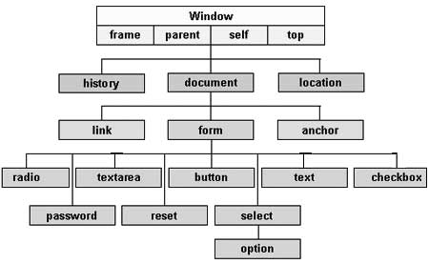
JavaScript DOM

Slide 4
DOM Hierarchy
The Objects are organized in a hierarchy. This hierarchical structure applies to the organization of objects in a Web document.
  Window object − Top of the hierarchy. It is the outmost element of the object hierarchy.
  Document object − Each HTML document that gets loaded into a window becomes a document object. The document contains the contents of the page.
  Form object − Everything enclosed in the <form>...</form> tags sets the form object.
  Form control elements − The form object contains all the elements defined for that object such as text fields, buttons, radio buttons, and checkboxes.

Slide 5
The Window Object
window.document.getElementById("header");
document.getElementById("header");
window.open() - open a new window
window.close() - close the current window
window.moveTo() - move the current window
window.resizeTo() - resize the current window
window.innerHeight - the inner height of the browser window (in pixels)
window.innerWidth - the inner width of the browser window (in pixels)

Slide 6
Window Location
window.location.href - returns the href (URL) of the current page
window.location.hostname - returns the domain name
window.location.pathname - returns the path and filename of current web page
window.location.protocol - returns the web protocol used
window.location.assign() - loads a new document

Slide 7
Window History
history.back() - same as clicking back in the browser
history.forward() - same as clicking forward in the browser

Slide 8
Document Object
document.getElementById(id) - Find an element by element id
document.getElementsByTagName(name) - Find elements by tag name
document.getElementsByClassName(name) - Find elements by class name

Slide 9
Let’s Understand it by Practical

Slide 10
Thank You

